Slide 1
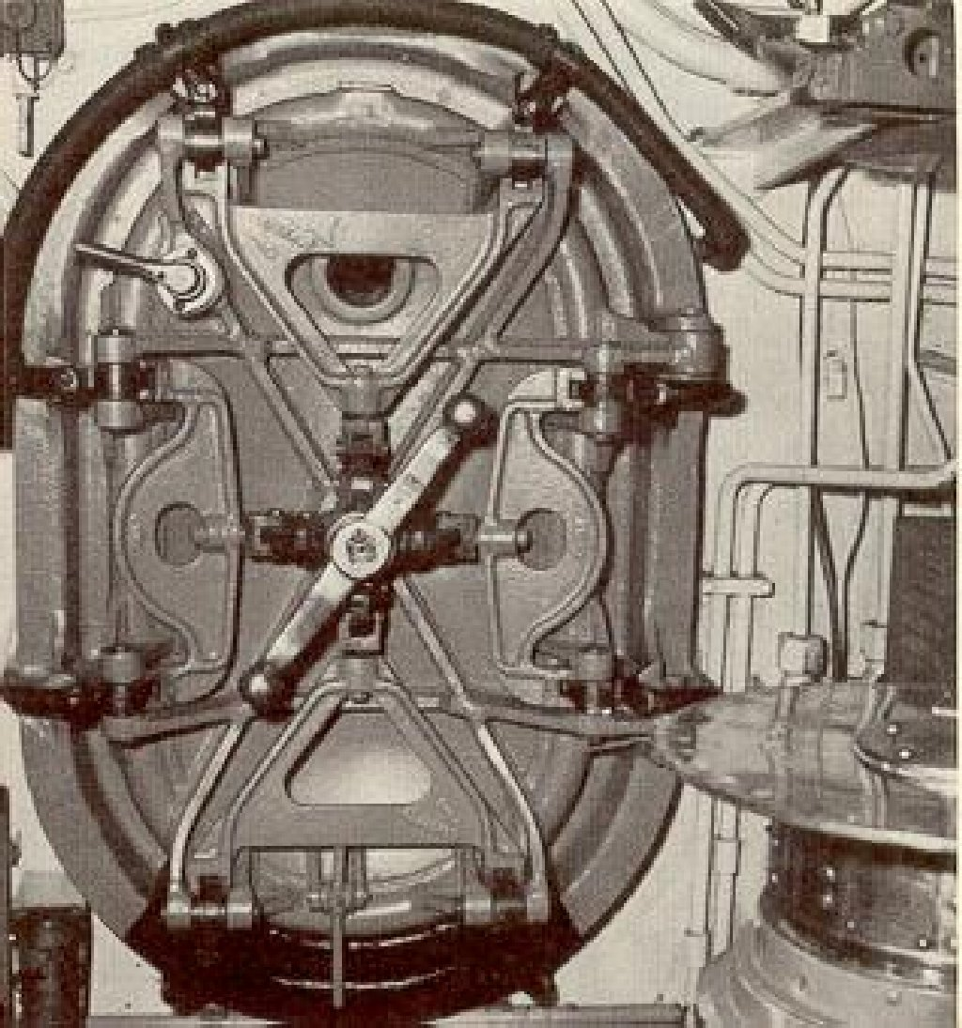
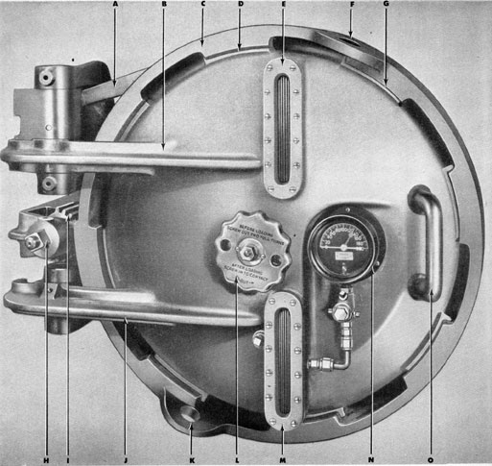
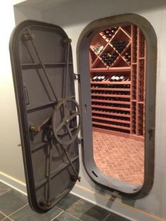
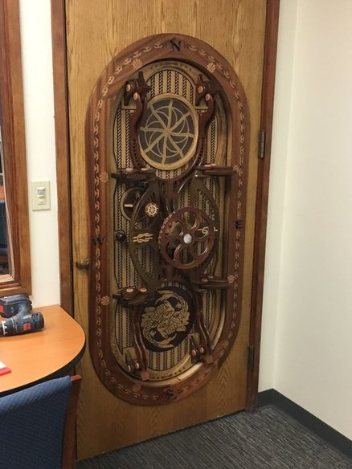
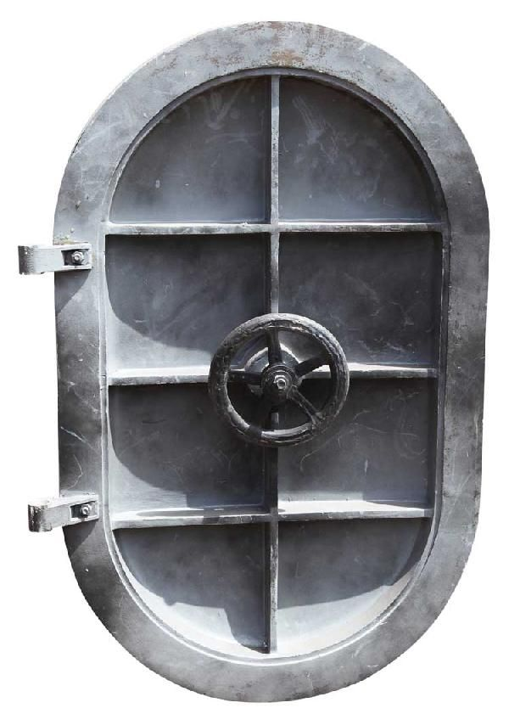
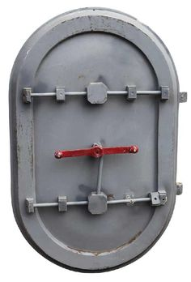
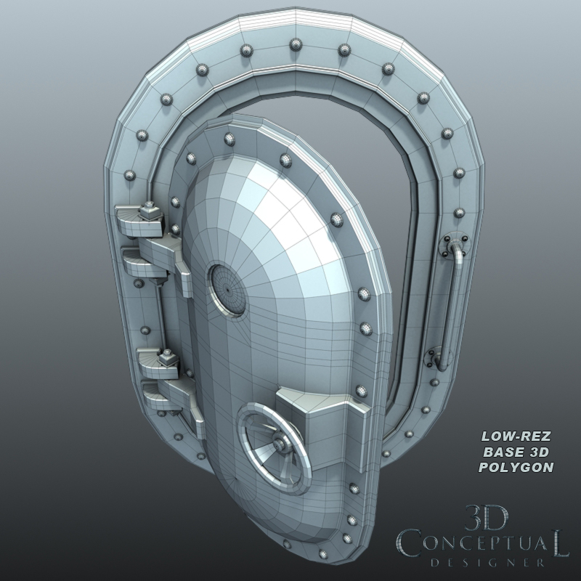
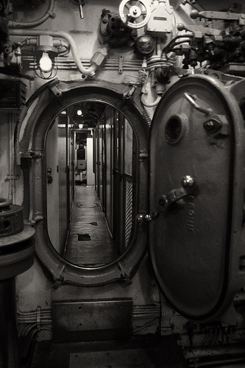
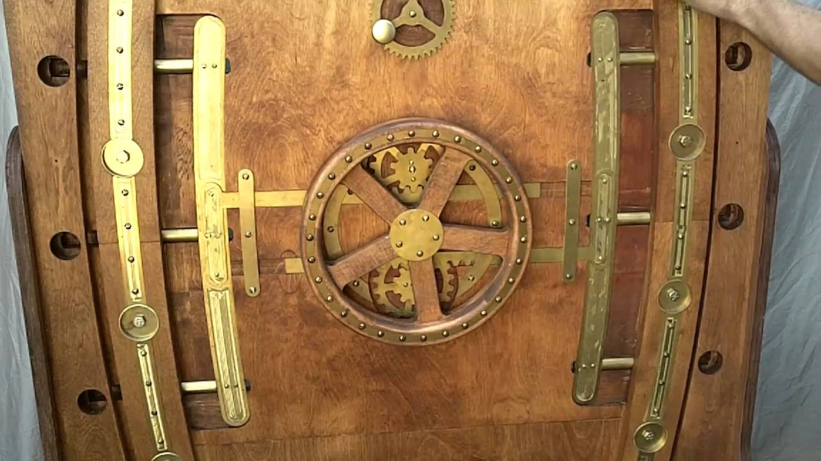
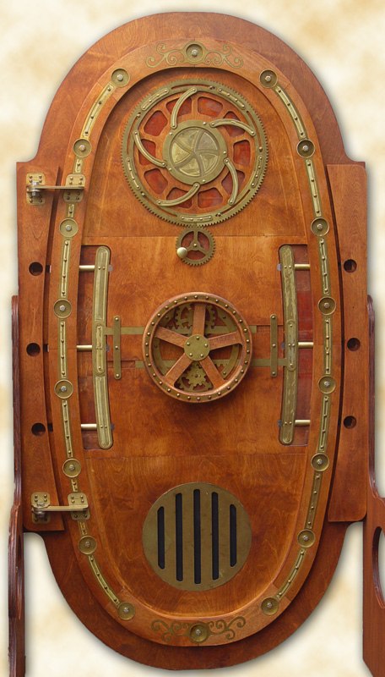
Interior door of a submarine. Notice the metallic, rough material that reflects only a little bit of light on the edges.
Smaller, circle port hole. Has a pressure gage located on the right.
A very cold texture/material. Looks worn down and used.
Interior door, notice the red handle.
The visualization of how a submarine door opens. Hinges, and opens outwards.
A visualization of what is usually around the doorway. Gages, pipes, wires, lights.
Not a typical submarine styled door. Looks steampunk styled.

